Slide 1

King County
Houses Sales Data
This Photo by Unknown Author is licensed under CC BY-SA

Slide 2

Contents
01
Overview
04
Regression Results
02
Business and Data Understanding
05
Conclusions
03
Modelling
06
Recommendations
This Photo by Unknown Author is licensed under CC BY-NC-ND

Slide 3
Overview
With nearly 2.2 million residents, King County is the largest county in Washington State. Nationally, it is the 13th largest by population and ninth-largest by total employment. Two million of its residents live in one of the 39 cities in the county and the remaining 200,000 in the unincorporated area. Seattle, the largest city in the county, is home to 730,000 residents
It is home to Seattle, the state's largest city, and is a hub of innovation, technology, and creative industries. The housing market in King County has been one of the fastest-growing in the country, with strong demand and limited supply leading to a highly competitive market
This Photo by Unknown Author is licensed under CC BY-NC-ND

Slide 4
Business Understanding
In response to demand for housing by high-earner households, new developers are planning to build new housing facilities. The agency is trying to figure out the attributes in homes that will have the greatest effects hence bring the greatest returns when selling the houses
Ax
This Photo by Unknown Author is licensed under CC BY-NC-ND

Slide 5
Exploratory Analysis
Types of Data Used
The two main types of data used was numerical data and categorical data. Numerical data was Date, Price, bathrooms, bedrooms, Living space size, Lot size, Floors, House Size, Basement size, Year renovated, Latitude & longitude. The categorical data used was Id, View, Condition, Grade and Zipcode
This Photo by Unknown Author is licensed under CC BY-NC-ND

Slide 6
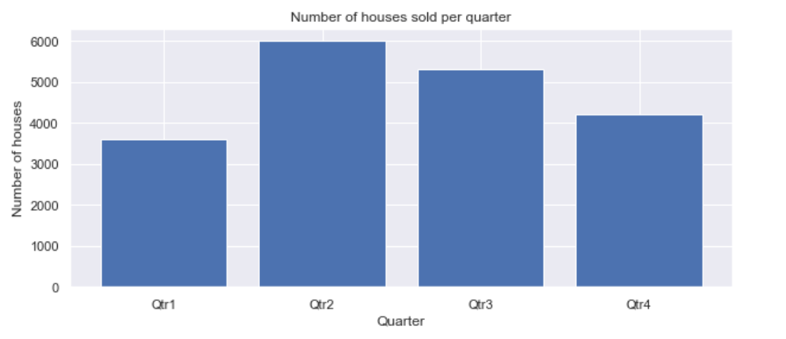
House Sale per Quarter
People in the King County region bought houses more in the second quarter of the year - trend shows seasonality of house sales
This Photo by Unknown Author is licensed under CC BY-NC-ND

Slide 7
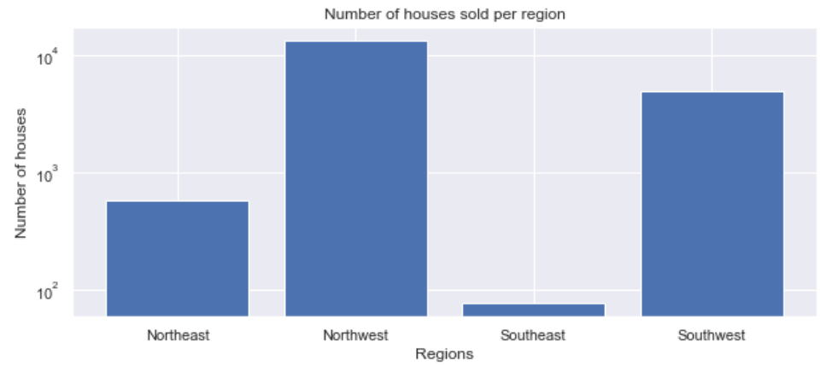
Number of Houses per Region
4
Majority of houses are sold in the NorthWest and SouthWest regions - making them ideal locations for developing property

Slide 8
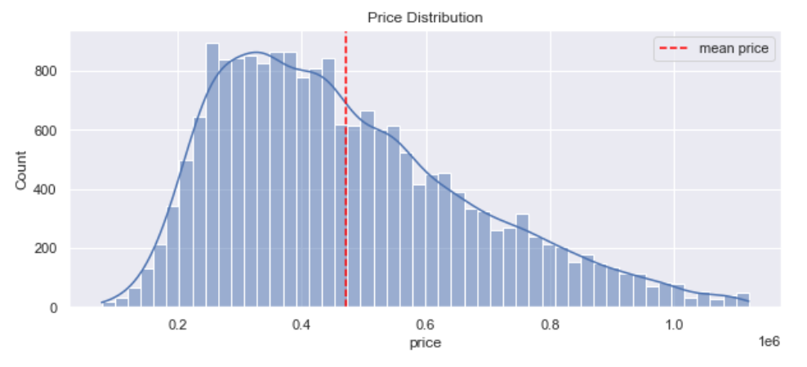
Distribution of House Prices
Price is almost normally distributed, with a positive skew. There are more lower priced houses, than highly priced houses
Maximum Price
$ 1,120,000
Average Price
$ 471,531
Minimum Price
$ 78,000

Slide 9
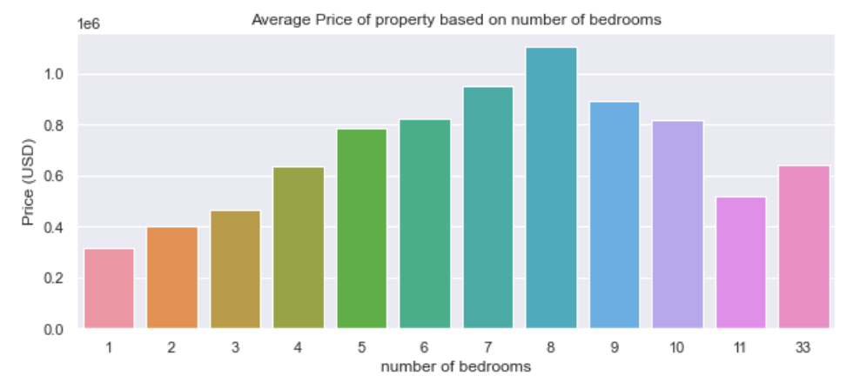
Average Property Price vs. Bedrooms
4
As the bedrooms increase, price increases, up to 8 bedrooms. Afterwards the price decreases

Slide 10
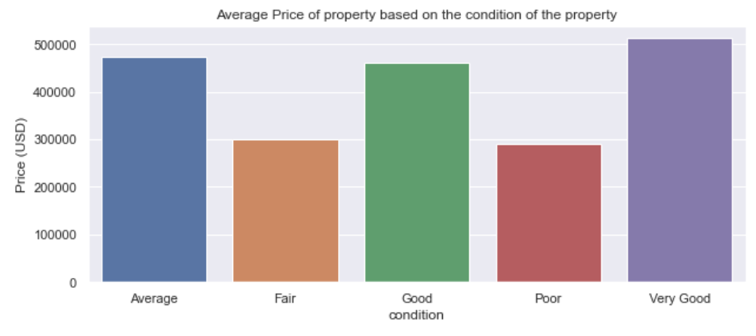
Average Property Price vs. Condition
As the condition of the house improves, price increases - houses with a very good condition have higher prices. Thus, keeping property in a good condition will higher valuation
This Photo by Unknown Author is licensed under CC BY-NC-ND

Slide 11
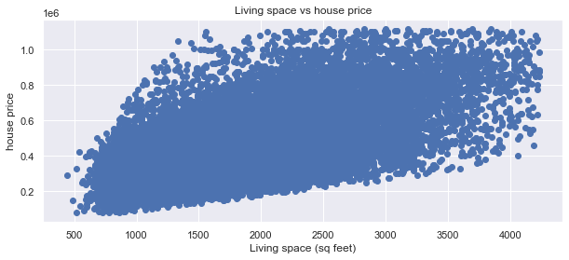
Regression Modelling
Simple Linear Regression
We created a model to predict price using Sqft_living as the independent variable and price as the dependent
Multiple Linear Regression
We created a model to predict price using bedrooms + bathrooms + sqft_living + sqft_lot + waterfront +floors +year +conditioning
This Photo by Unknown Author is licensed under CC BY-NC-ND

Slide 12
Regression Results
Simple Linear: Price vs Sqft_Living
The r-squared value, 0.363, shows that the model can account for about 36.3% of the variability of price around its mean. All of the p-values round to 0.. An increase of 1 sq foot in sqft_living will result in an increase in house price by USD 122100
Multiple Linear Regression
The r-squared value, 0.608, shows that the model can account for about 60.8% of the variability of price around its mean with all the p values around 0 which implies that a null hypothesis developed can be rejected
This Photo by Unknown Author is licensed under CC BY-NC-ND

Slide 13
Conclusions
The multiple linear regression model is better than the simple regression models as it had a higher R-squared value (60.8% vs. 36.3%). This shows that categorical variables had a positive effect on the prices as illustrated in the univariate analysis.
Bedrooms, bathrooms, square footage of living space, number of floors, and the condition of the house are all significant predictors of the price of a house.
The quarter of the year in which the house was sold also appears to have a small effect on the price.
The limitations of the data used to train the model should be considered
This Photo by Unknown Author is licensed under CC BY-NC-ND

Slide 14
Recommendations
Focus on important features: realtors should consider the importance of the number of bedrooms, number of bathrooms, and square footage of the living area when determining a property's value.
In particular, an increase of 1 sq foot in sqft_living will result in an increase in house price by USD 169.85,
An increase in 1 bathroom results in an increase in price by USD 15120.0.
However, an increase in 1 bedroom results in a decrease in price by USD 22130.0. Realtors should consider these features when pricing a property or advising sellers on what features to highlight in a property.
Highlight desirable locations: realtors to consider the location of a property, especially in terms of the region it is located in.
Realtors should inform clients that different regions have different associated increases or decreases in price. In particular, the north-west region has an associated increase in price of about USD 107500.0, while the south-west has an associated decrease in price of about USD 102100.0.
Realtors should ensure that the condition of a property is highlighted in any marketing materials or listings, and they should take steps to ensure that the view from the property is presented in the best possible light:
For example, having an "EXCELLENT" view is associated with an increase in price of about USD 142900.0
Having no view (“NONE”) is associated with a decrease in price of about USD 76080.0.
Similarly, having a "GOOD" condition is associated with an increase in price of about USD 36110.0
While having a "FAIR" condition is associated with a decrease in price of about USD 44500.0.
This Photo by Unknown Author is licensed under CC BY-NC-ND

Slide 15

Thank you!
Feel free to reach out to us if you have any questions.

